Slide 1



MS Access
Class VIII
lab 27

Slide 2

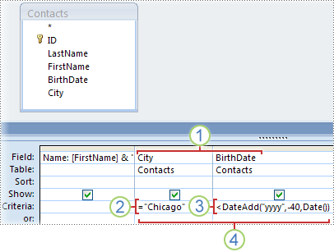
Query Criteria
Query criteria helps you to retrieve specific items from an Access database

Slide 3
Query Criteria
Query criteria helps you to retrieve specific items from an Access database

Slide 4
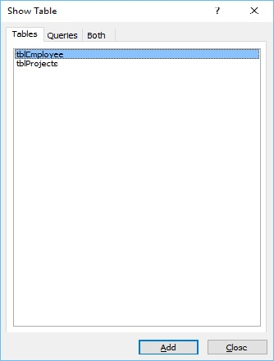
Query Design
open your Access database and then go to the Create tab and click on Query Design.

Slide 5
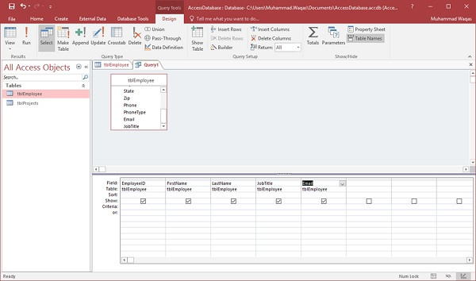
Add Field to the Query

Slide 6
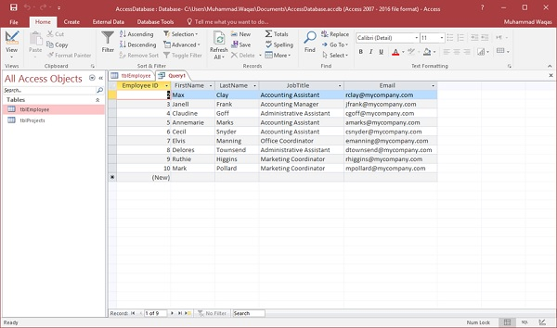
Run Your Query

Slide 7
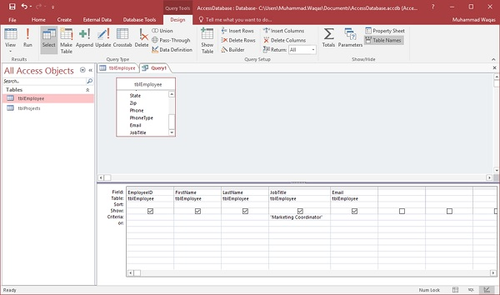
Adding Criteria
If you want to see only those whose JobTitle are Marketing Coordinator then you will need to add the criteria for that

Slide 8

AND Operator
If you need to use the functionality of the AND operator, then you have to specify the other condition in the Criteria row

Slide 9



